Slide 1
Software Testing
Input Space Partition Testing

Slide 2
Input Space Coverage
Four Structures for Modeling Software
Graphs
Logic
Input Space
Syntax
Applied to
Applied to
Applied to
Source
FSMs
Specs
DNF
Source
Specs
Source
Models
Design
Use cases
Integ
Input

Slide 3
Benefits of ISP
Can be equally applied at several levels of testing
  Unit
  Integration
  System
Relatively easy to apply with no automation
Easy to adjust the procedure to get more or fewer tests
No implementation knowledge is needed
  just the input space

Slide 4
Test Data and Test Cases
Test data: Inputs which have been devised to test the system.
Test cases: Inputs to test the system and the predicted outputs from these inputs if the system operates according to its specification.

Slide 5
Black-box testing
Characteristics of Black-box testing:
  Program is treated as a black box.
  Implementation details do not matter.
  Requires an end-user perspective.
  Criteria are not precise.
  Test planning can begin early.

Slide 6
Input Domains
The input domain to a program contains all the possible inputs to that program
For even small programs, the input domain is so large that it might as well be infinite
Testing is fundamentally about choosing finite sets of values from the input domain

Slide 7
Input Domains
Input parameters define the scope of the input domain
  Parameters to a method
  Data read from a file
  Global variables
  User level inputs
Domain for each input parameter is partitioned into regions
At least one value is chosen from each region

Slide 8
Data Testing
If you think of a program as a function, the input of the program is its domain.
Examples of program data are:
  words typed into MS Word
  numbers entered into Excel
  picture displayed in Photoshop
  the number of shots remaining in an arcade game
  …

Slide 9
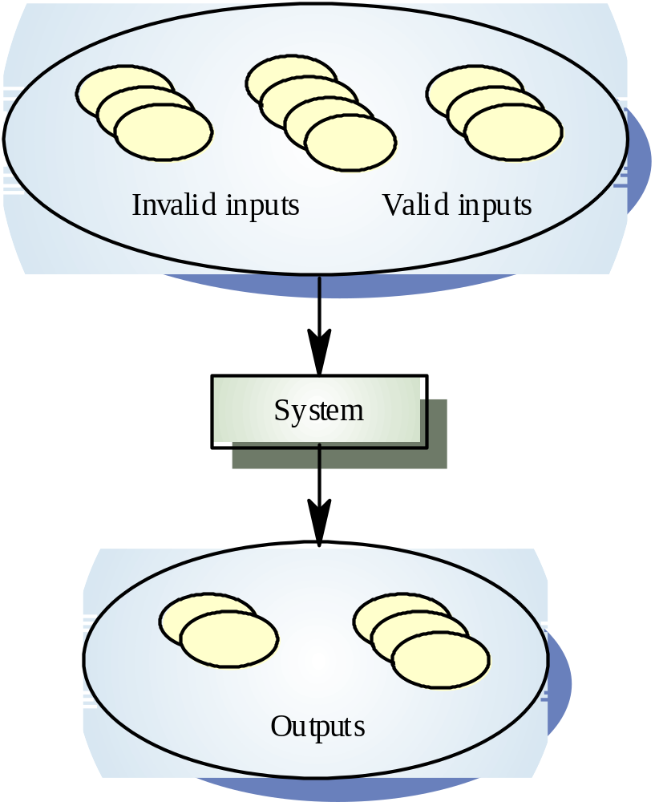
Equivalence
Partitioning
Equivalence partitioning is the process of methodically reducing the huge (or infinite) set of possible test cases into a small, but equally effective, set of test cases.

Slide 10
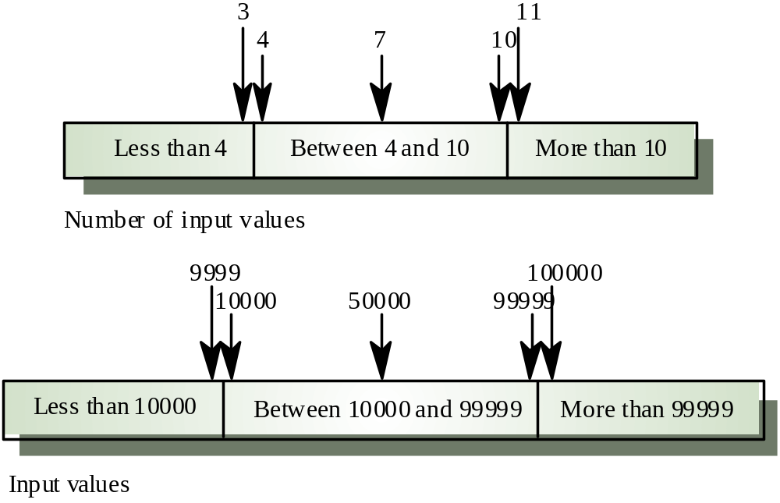
Equivalence partitions

Slide 11
Partitioning Domains
Domain D
Partition scheme q of D
The partition q defines a set of blocks, Bq = b₁ , b₂ , … b_{Q}
The partition must satisfy two properties :
  blocks must be pairwise disjoint (no overlap)
  together the blocks cover the domain D (complete)
b₁
b₂
b_{i} ∩ b_{j} = Φ, ∀ i ≠ j, b_{i}, b_{j} ∈ B_{q}
b₃
∪ b = D
b ∈ Bq

Slide 12
Using Partitions – Assumptions
Choose a value from each partition
Each value is assumed to be equally useful for testing
Application to testing
  Find characteristics in the inputs : parameters, semantic descriptions, …
  Partition each characteristic
  Choose tests by combining values from characteristics
Example Characteristics
  Input X is null
  Order of the input file F (sorted, inverse sorted, arbitrary, …)
  Input device (DVD, CD, VCR, computer, …)

Slide 13
Example: Loan application
2-64 chars.
Customer Name
Account number
Loan amount requested
Term of loan
Monthly repayment
Term:
Repayment:
Interest rate:
Total paid back:
6 digits, 1st
non-zero
£500 to £9000
1 to 30 years
Minimum £10
Choosing (or defining) partitions seems easy, but is easy to get wrong

Slide 14
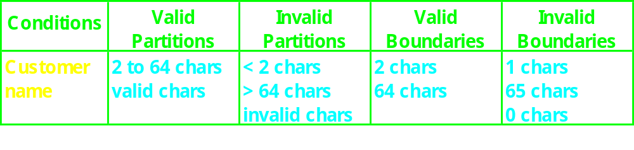
Customer name
Number of characters:
1
2
64
65
invalid
valid
invalid
Valid characters:
A-Z
a-z
Any
other
-’
space

Slide 15
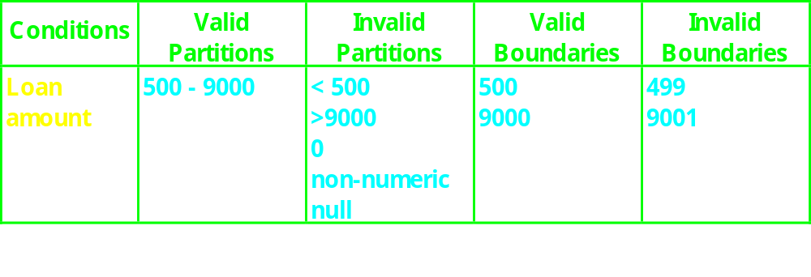
Loan amount
499
500
9000
9001
invalid
valid
invalid

Slide 16
Design test cases
Test
Description
Expected Outcome
New Tags
Case
Covered
1
Name: John Smith
Acc no: 123456
Loan: 2500
Term: 3 years
Term: 3 years
Repayment: 79.86
Interest rate: 10%
Total paid: 2874.96
V1, V2,
V3, V4,
V5 .....
2
Name: AB
Acc no: 100000
Loan: 500
Term: 1 year
Term: 1 year
Repayment: 44.80
Interest rate: 7.5%
Total paid: 537.60
B1, B3,
B5, .....

Slide 17
Search routine specification
procedure Search (Key : INTEGER ; T: array 1..N of INTEGER;
Found : BOOLEAN; L: 1..N) ;
Pre-condition
-- the array has at least one element
1 <= N
Post-condition
-- the element is found and is referenced by L
( Found and T (L) = Key)
or
-- the element is not in the array
( not Found and
not (exists i, 1 >= i >= N, T (i) = Key ))

Slide 18
Search routine input partitions
Inputs which conform to the pre-conditions.
Inputs where a pre-condition does not hold.
Inputs where the key element is a member of the array.
Inputs where the key element is not a member of the array.

Slide 19
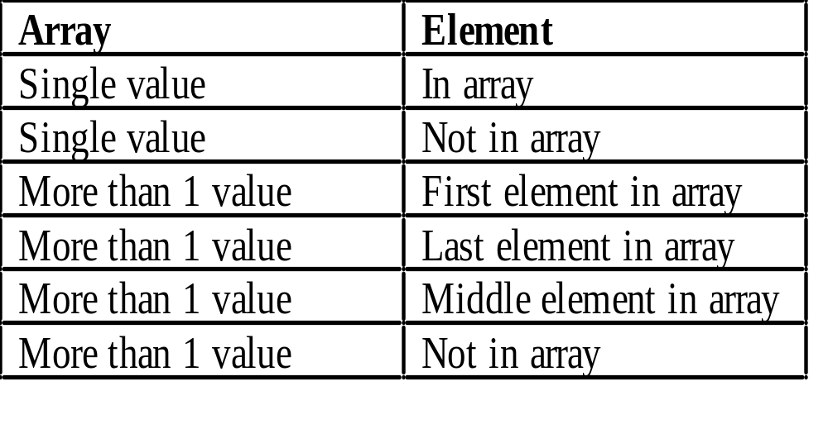
Search routine input partitions

Slide 20
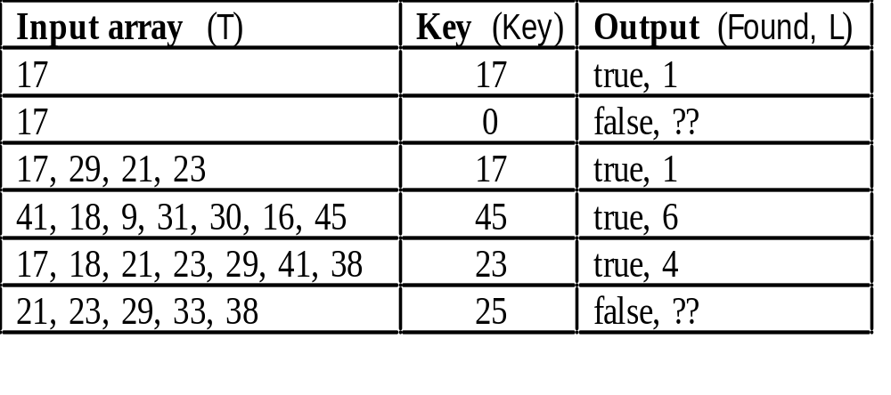
Search routine test cases

Slide 21
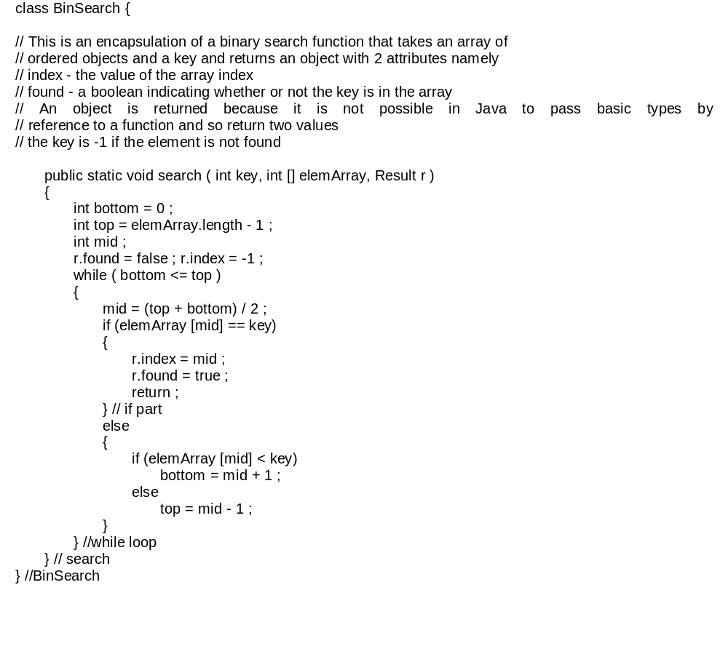
Binary search (Java)

Slide 22
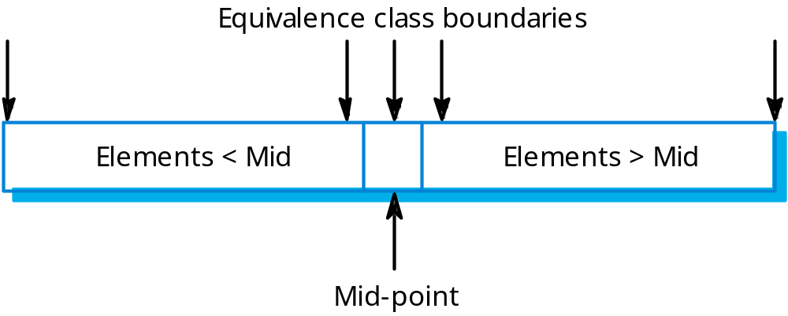
Binary search equiv. partitions

Slide 23
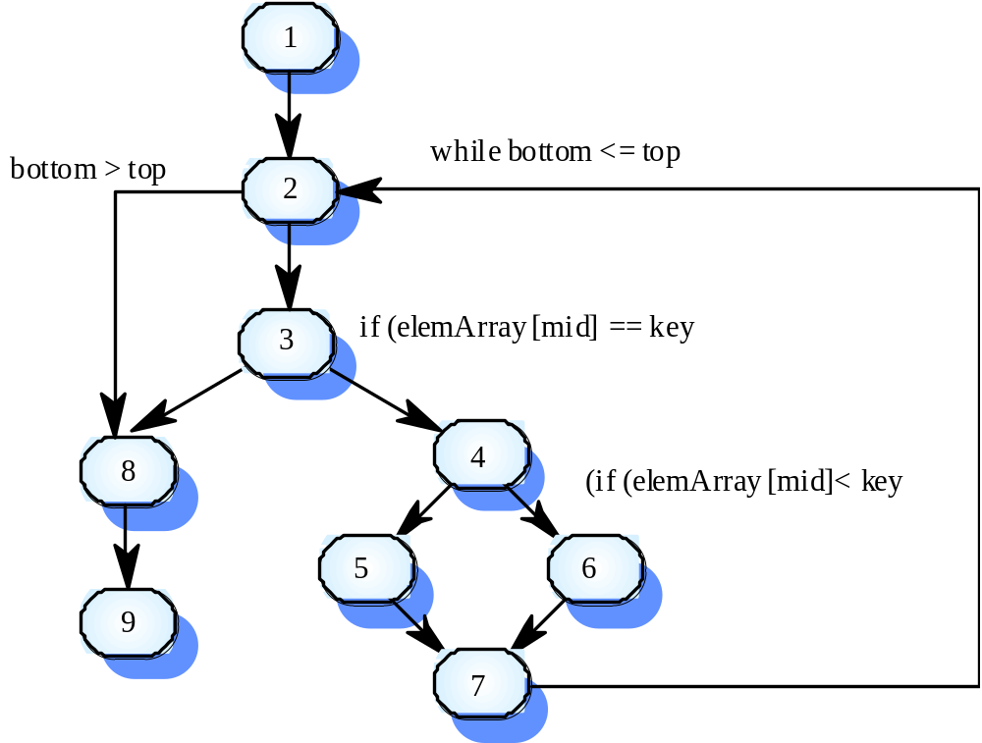
Binary search flow graph

Slide 24
Independent paths
1, 2, 3, 8, 9
1, 2, 3, 4, 6, 7, 2
1, 2, 3, 4, 5, 7, 2
1, 2, 3, 4, 6, 7, 2, 8, 9
Test cases should be derived so that all of these paths are executed
A dynamic program analyser may be used to check that paths have been executed

Slide 25
Two Approaches to Input Domain Modeling
Interface-based approach
  Develops characteristics directly from individual input parameters
  Simplest application
Functionality-based approach
  Develops characteristics from a behavioral view of the program under test
  Harder to develop—requires more design effort
  May result in better tests, or fewer tests that are as effective

Slide 26
1. Interface-Based Approach
Mechanically consider each parameter in isolation
This is an easy modeling technique and relies mostly on syntax
Some domain and semantic information won’t be used
Ignores relationships among parameters

Slide 27
2. Functionality-Based Approach
Identify characteristics that correspond to the intended functionality
Requires more design effort from tester
Can incorporate domain and semantic knowledge
Can use relationships among parameters
Modeling can be based on requirements, not implementation
The same parameter may appear in multiple characteristics, so it’s harder to translate values to test cases

Slide 28
Identifying Functionalities, Parameters and Characteristics
Interface-based : Translate parameters to characteristics
Candidates for characteristics :
  Preconditions and postconditions
  Relationships among variables
  Relationship of variables with special values (zero, null, blank, …)
Should not use program source – characteristics should be based on the input domain
  Program source should be used with graph or logic criteria

Slide 29
Interface vs Functionality-Based
public boolean findElement (List list, Object element)
// Effects: if list or element is null throw NullPointerException
// else return true if element is in the list, false otherwise
Interface-Based Approach
Two parameters : list, element
Characteristics :
list is null (block1 = true, block2 = false)
list is empty (block1 = true, block2 = false)
Functionality-Based Approach
Two parameters : list, element
Characteristics :
number of occurrences of element in list
(0, 1, >1)
element occurs first in list
(true, false)
element occurs last in list
(true, false)

Slide 30
Example Handling Constraints
Sorting an array
  Input : variable length array of arbitrary type
  Outputs : sorted array, largest value, smallest value
Characteristics:
Length of array
Type of elements
Max value
Min value
Position of max value
Position of min value
Partitions:
Len { 0, 1, 2..100, 101..MAXINT }
Type { int, char, string, other }
Max { ≤0, 1, >1, ‘a’, ‘Z’, ‘b’, …, ‘Y’ }
Min { … }
Max Pos { 1, 2 .. Len-1, Len }
Min Pos { 1, 2 .. Len-1, Len }

Slide 31
Example: student access
A university computer system allows students an allocation of disc space depending on their projects.
If they have used all their allotted space, they are only allowed restricted access, i.e. to delete files, not to create them. This is assuming they have logged on with a valid username and password.
What are the input and output conditions?

Slide 32
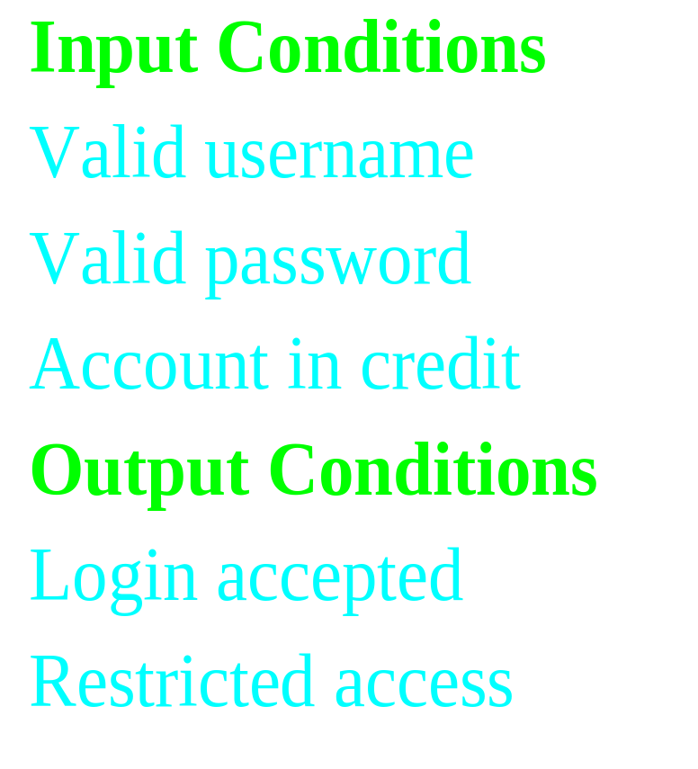
List the input and output conditions
list the ‘input conditions’ in the first column of the table
list the ‘output conditions’ under the input conditions

Slide 33
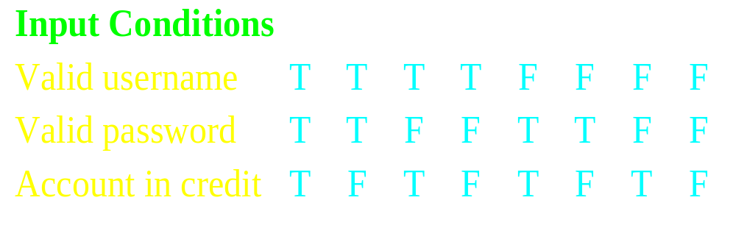
Determine input combinations
add columns to the table for each unique combination of input conditions.
each entry in the table may be either ‘T’ for true, ‘F’ for false.

Slide 34
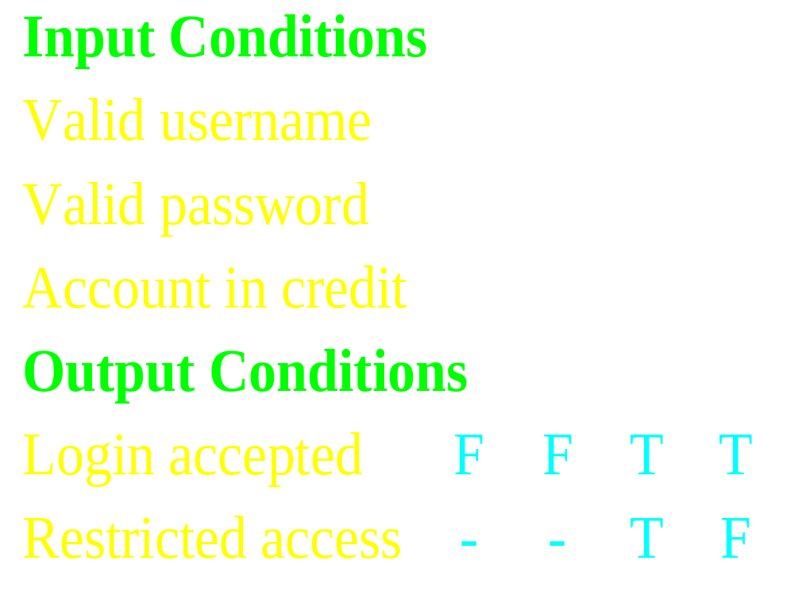
Complete the table
determine the expected output conditions for each combination of input conditions

Slide 35
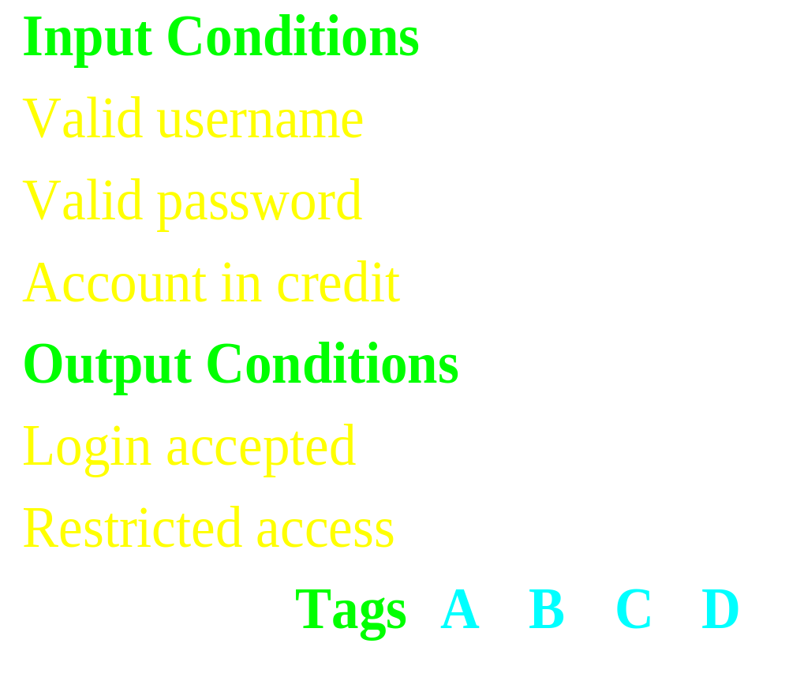
Determine test case groups
each column is at least one test case

Slide 36
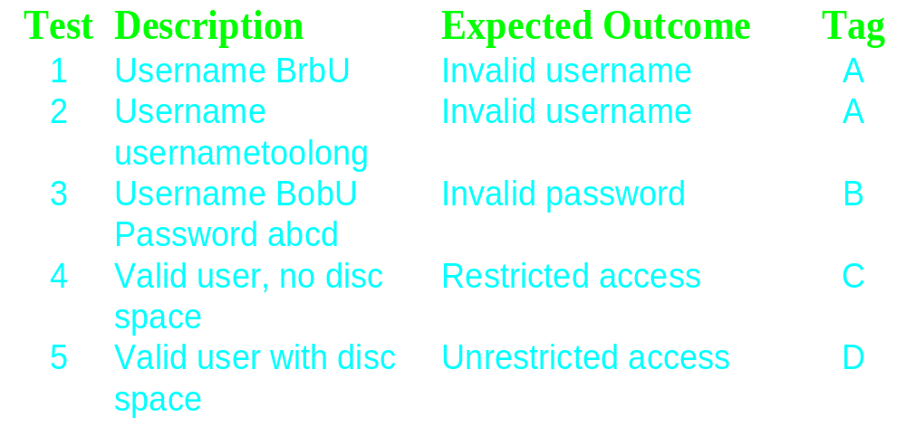
Design test cases
usually one test case for each column but can be none or several

